Slide 1

BLUETOOTH CONTROLLED ROBOTIC ARM USING 8051 MICROCONTROLLER
The Bluetooth-controlled robot project combines hardware and software components, featuring an 8051 microcontroller, motor driver circuitry, DC motors, Bluetooth module, and Android mobile device. The Android app serves as a user-friendly interface for sending commands, enabling remote control of the robot's movements - forward, backward, left, and right. The microcontroller acts as the central processing unit, managing Bluetooth communication and translating user input into motor control signals. This integration fosters hands-on learning in microcontroller programming, Bluetooth communication, motor control circuits, and Android app development. The project offers both educational value and potential for expansion with additional sensors, making it an excellent choice for robotics enthusiasts, hobbyists, and students.

Slide 2

INTRODUCTION
Creating a Bluetooth-controlled robot using an 8051 microcontroller and an Android mobile device can be a fun and educational project. In this project, you will use Bluetooth communication to control the robot's movement (forward, backward, left, right) from your Android mobile phone. Here's a step-by-step guide on how to build such a robot.
Robotic arms have revolutionized various industries by providing precision and versatility in tasks ranging from manufacturing to healthcare. One way to enhance the usability of such robotic arms is by incorporating wireless control systems, and Bluetooth technology is an excellent choice for this purpose. In this project, we will introduce a Bluetooth controlled robotic arm that is driven by a popular microcontroller, the 8051.
The 8051 microcontroller is a widely used microcontroller known for its reliability and versatility. It can be programmed to control various electronic systems and interfaces effectively with other hardware components. When combined with Bluetooth communication, it allows for remote control and automation of a robotic arm.

Slide 3
HARDWARE & SOFTWARE REQUIREMENTS
Hardware Requirements
Microcontroller System
Bluetooth Module
Motor Drivers
Power Supply
Sensors (Optional)
Chassis and Structure
Connectors and Wiring
Software Requirements:
Embedded C Compiler
Integrated Development Environment (IDE)
Motor Control Code
Bluetooth Communication Code
Control Interface
Driver Libraries
Optional: Feedback Control Code
Documentation

Slide 4
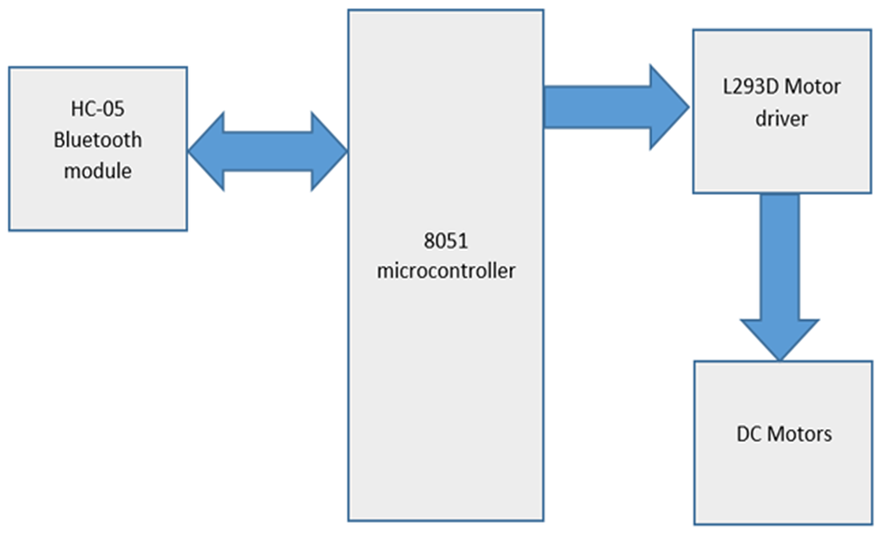
BLOCK DIAGRAM

Slide 5
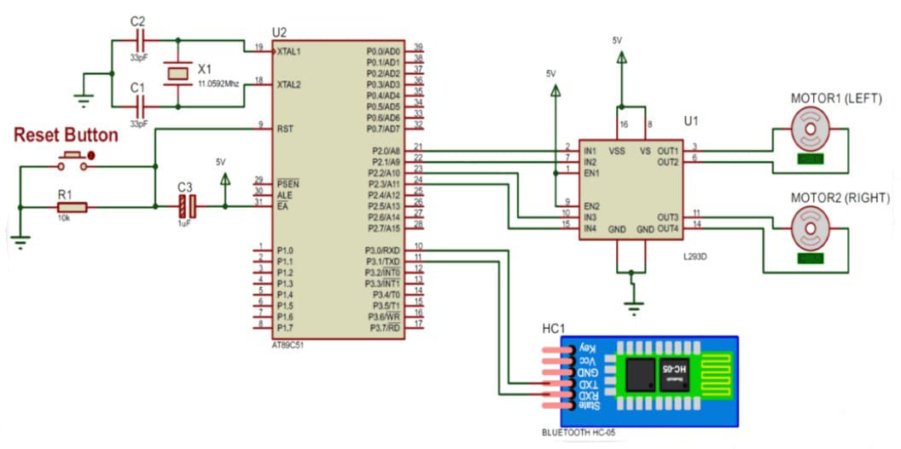
circuit diagram

Slide 6
PROJECT DESCRIPTION
The project aims to showcase the integration of an 8051 microcontroller with motors for robotic arm movements and Bluetooth communication for remote control.
It requires:
8051 Microcontroller: The central processing unit that controls the robotic arm's movements and functions.
Bluetooth Module (HC-05/HC-06): Enables wireless communication between the microcontroller and a Bluetooth-enabled device (e.g., smartphone, tablet, or computer).
DC Motors or Servo Motors: To actuate the joints and movements of the robotic arm.
Power Supply: Provides the necessary power for the microcontroller, motors, and other electronic components.
Mechanical Structure: The physical framework of the robotic arm, including joints and links, designed to mimic human arm movements.
Motor Drivers: Circuits or modules to control the speed and direction of the motors.
Control Interface (Android App): An application on a Bluetooth-enabled device to send control signals to the robotic arm.

Slide 7

THANK YOU

